Slide 1
Gas Laws
sksksksk

Slide 2
Three Concepts

Slide 3
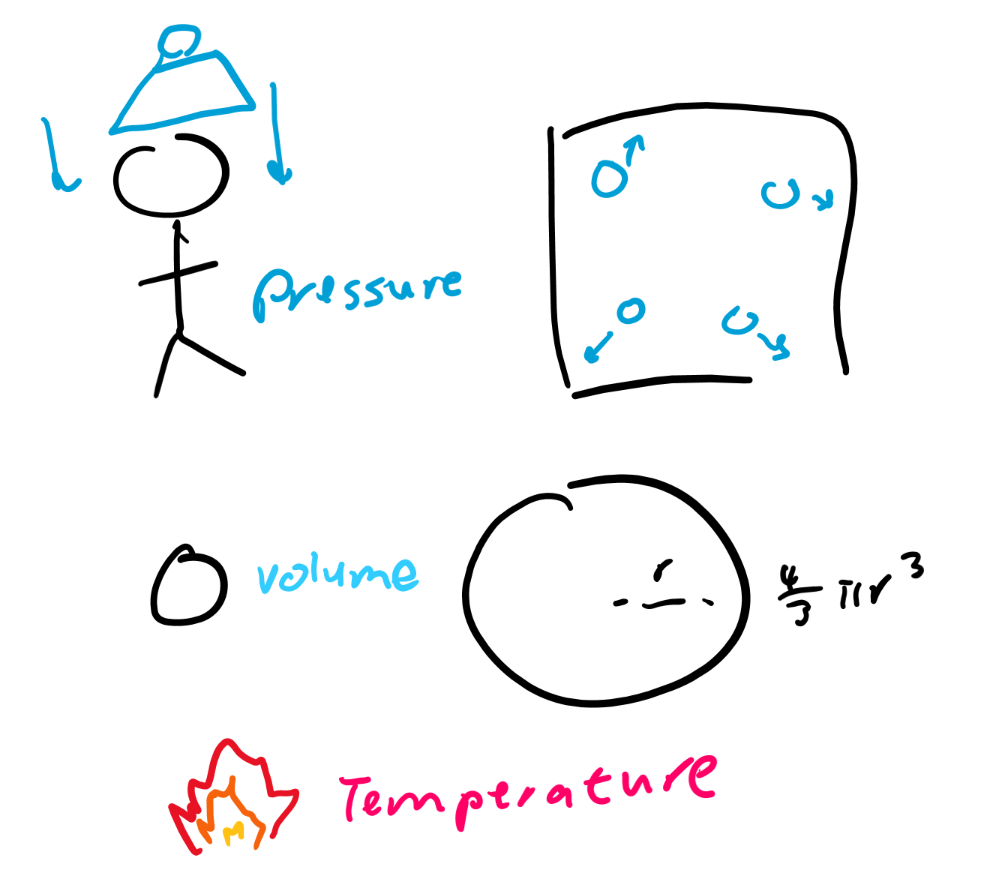
Review
What’s pressure?
What’s volume?
What’s temperature?
Our first three laws will only deal with these three things.

Slide 4
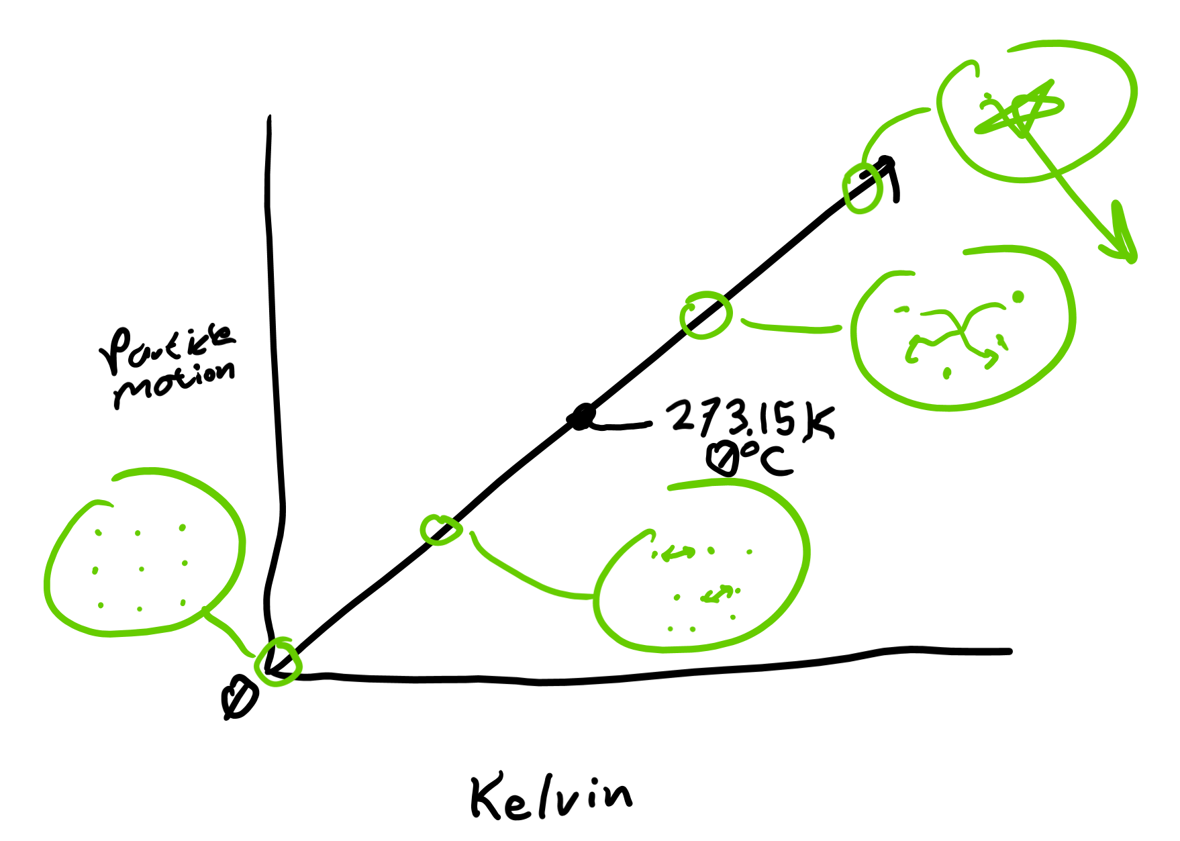
Absolute values
Absolute volume: 0 means nothing, none of it exists
0 volume means nothing. Liters does this because 0 liters is 0 volume
0 pressure means nothing. Atms does this because 0 atms is no pressure at all
0 temperature means nothing. Celsius doesn’t do this because molecules are still moving (have temperature values at 0 degrees)
We have to use “Kelvin” which sets 0 to “absolute zero” where there is no temperature

Slide 5
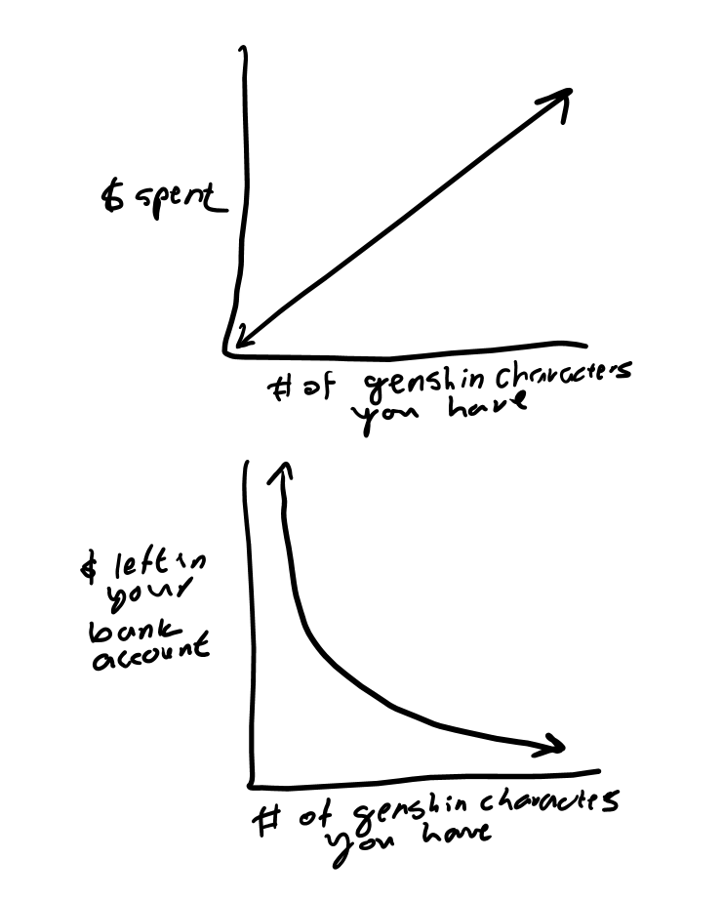
Proportional vs Inverse
Proportional: if two things are proportional, increasing one will increase the other; decreasing one will decrease another
Inversely proportional: if two things are inversely proportional, increasing one will decrease the other; decreasing one will increase the other
What are some things that are proportional?
Inversely proportional?

Slide 6
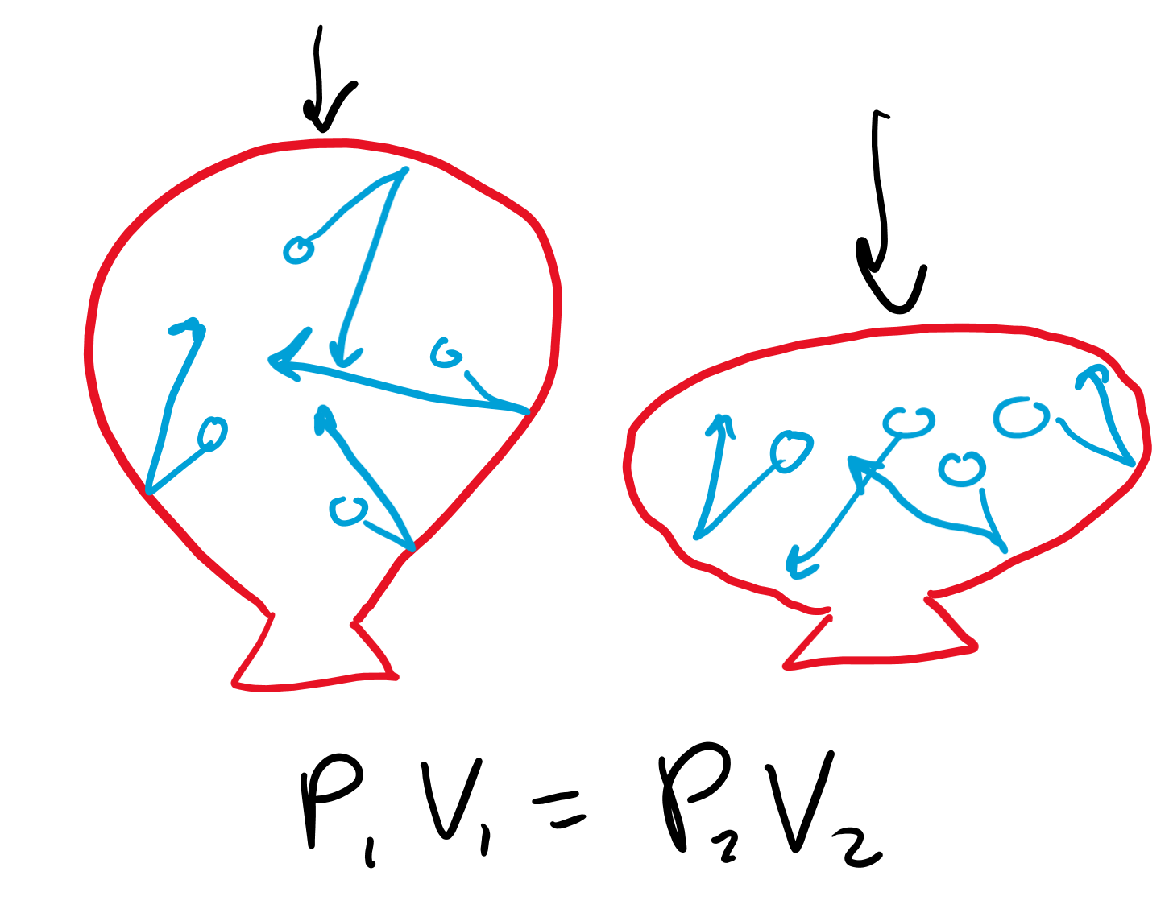
Boyle’s Law
If you squeeze a balloon (decrease the volume), what happens to the size of the balloon?
If you stretch out a balloon (increase the volume) what happens to its pressure?
How to remember: boyle sounds like boil, like temperature, but this one has no temperature, ez dubskis

Slide 7
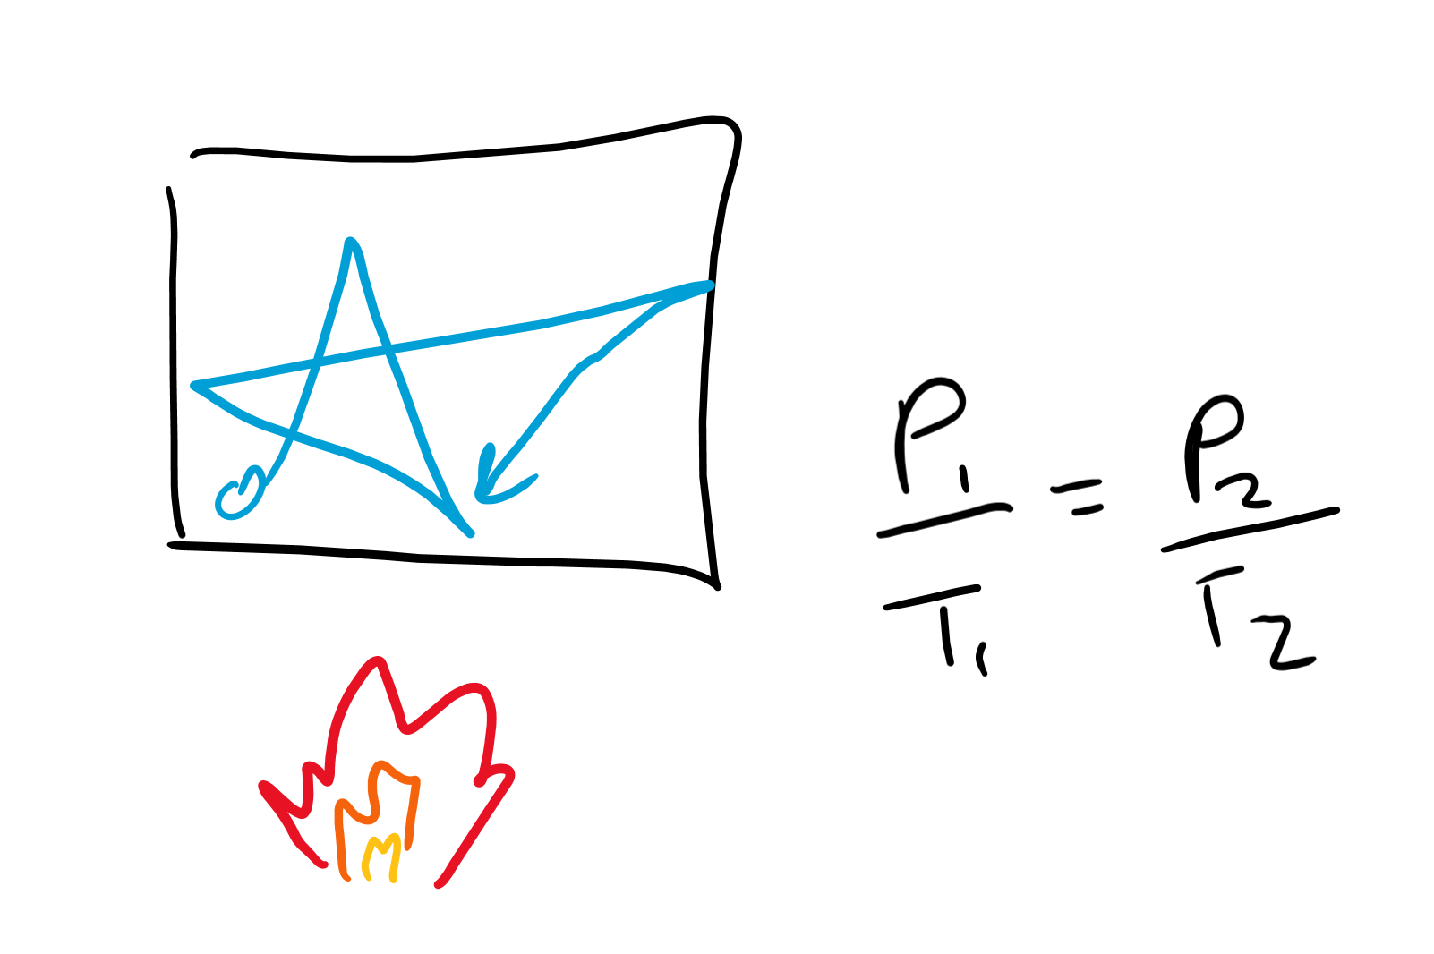
Gay Lussac’s Law
If you increase the temperature of a gas, what happens to the speed at which the gasses move?
So what happens to the pressure?
If you decrease temperature, what should happen to pressure?
How to remember: he’s French, and name a country under more heat (close enough to temperature) and pressure in WWII

Slide 8
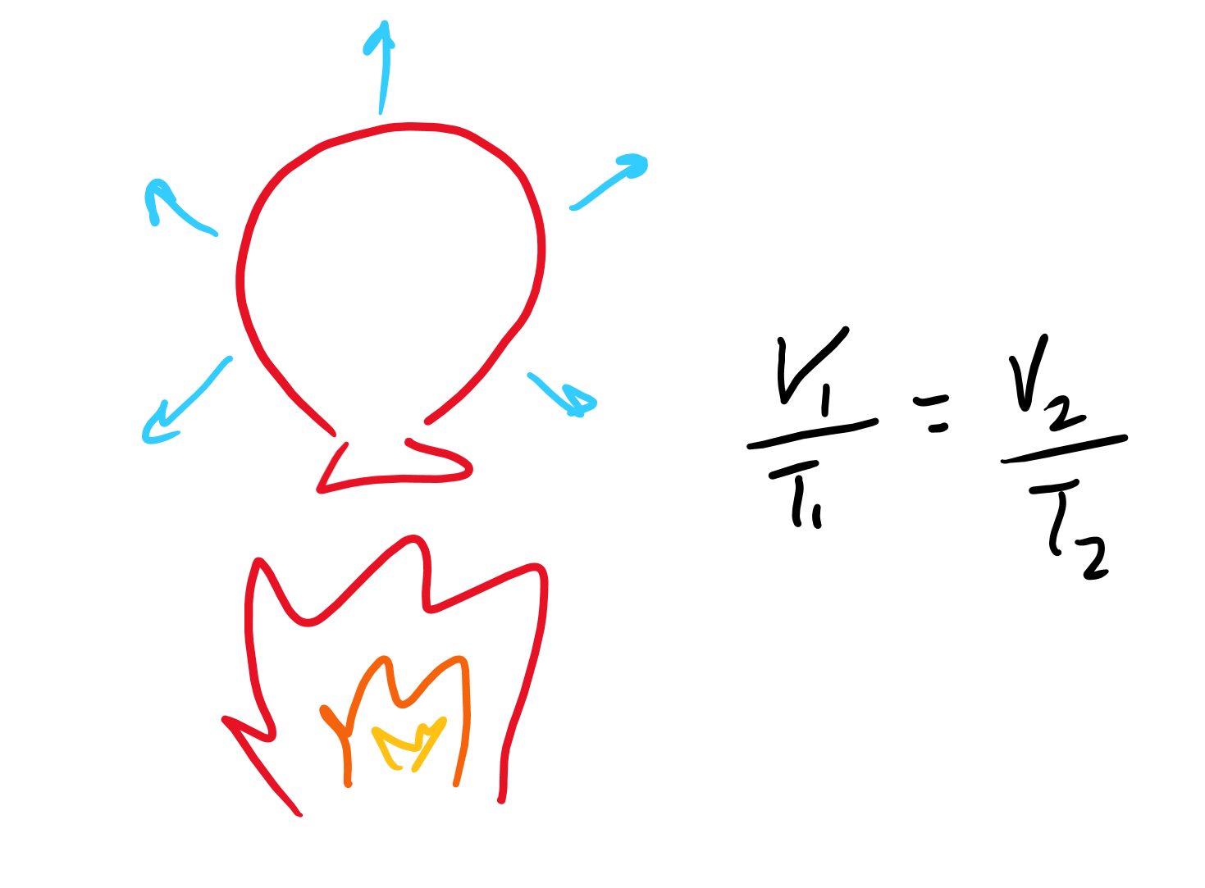
Charles’ Law
If you increase the temperature, what happens to particular motion?
What happens to the pushing against the walls of the container?
If the container can change size (like a balloon), what is going to happen to the size?
If you decrease temperature what happens to volume?
How to remember: Charles is “PR”etty basic and “PR”essure is held constant

Slide 9
Combined

Slide 10
Let’s talk relationships
If volume is increased, what can happen to
Temperature?
Pressure?
If pressure is increased, what can happen to
Volume?
Temperature?
If temperature is increased, what can happen to
Volume?
Pressure?

Slide 11
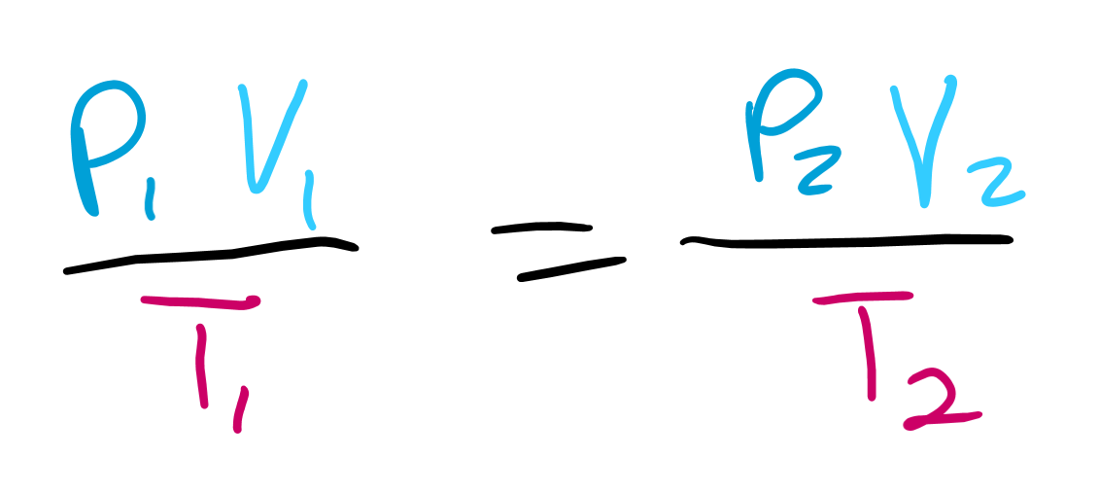
Combined gas law
V, P are multiplied (inverse)
V, T are divided (proportional)
P, T are divided (proportional)

Slide 12
Moles

Slide 13
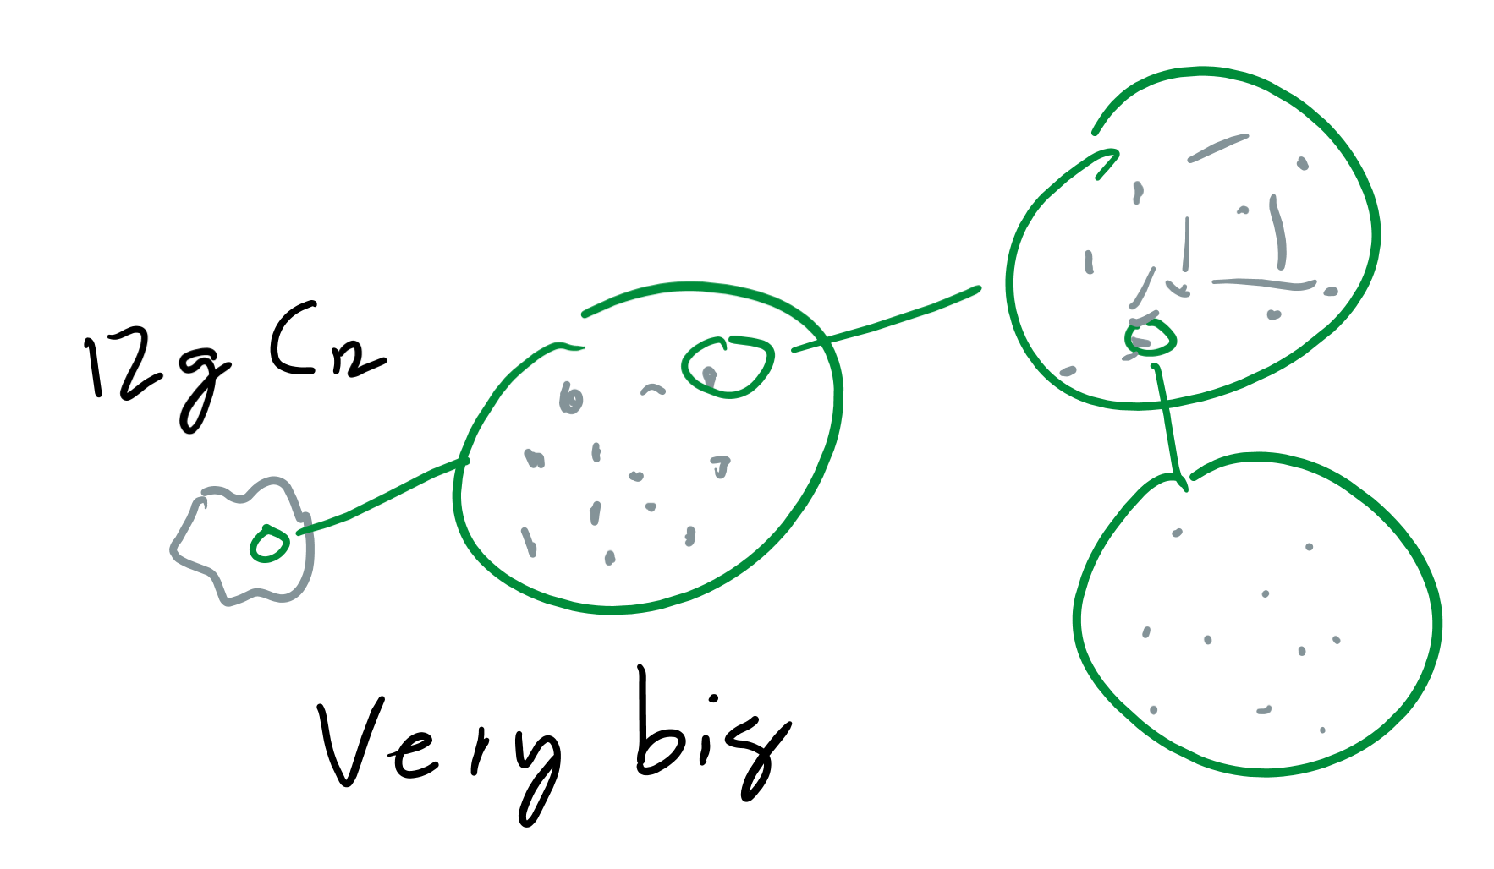
What is a mole?
Exact definition: the amount of Carbon-12 molecules in a 12 gram sample
Close enough definition: about 6.022 * 10^23 amount of an object
If I have a mole of cars, how many cars do I have?
Moles are just a measurement of quantity

Slide 14
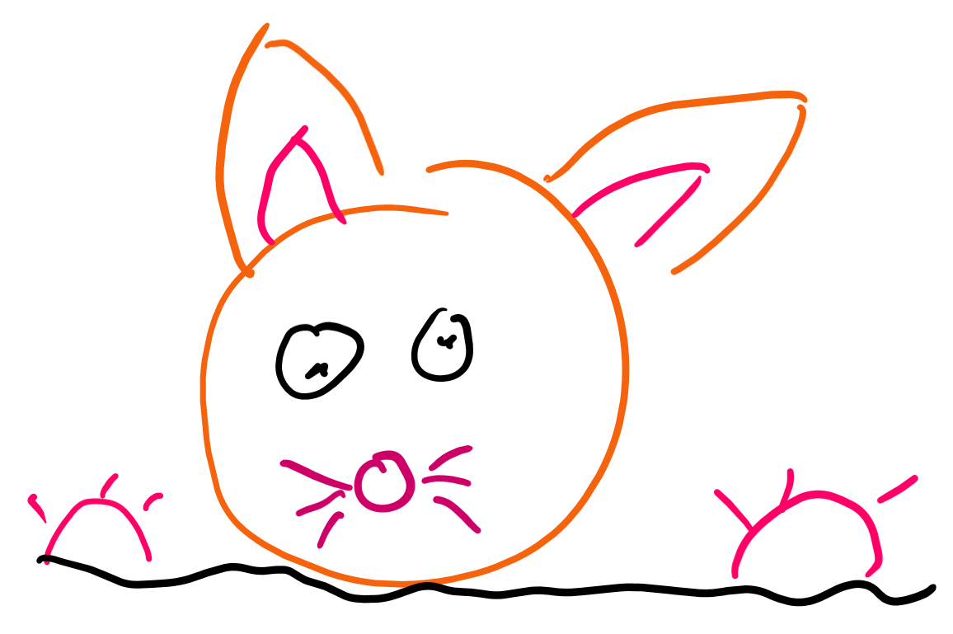
Avagadro’s Number
Yeah it’s just the 6.022 * 10^23 number, but it has a fancy name for the guy that discovered it, here’s a slide with a picture of a mole, though, for the funnies

Slide 15
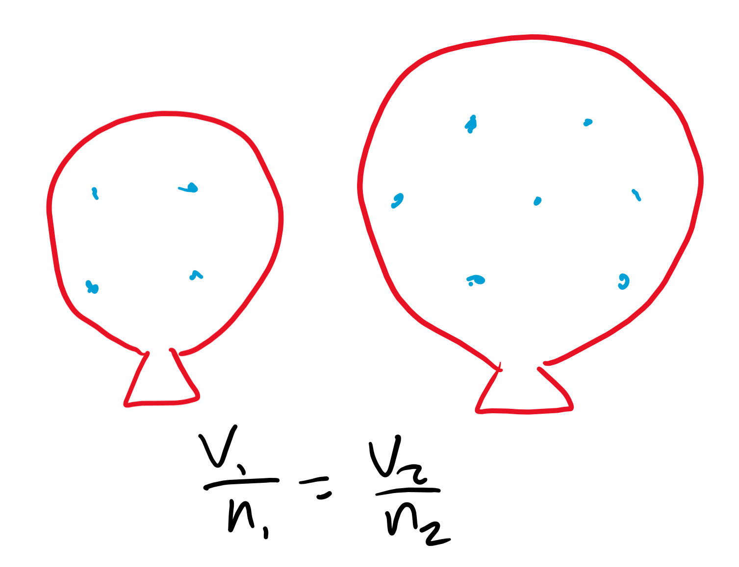
Avocado’s Law
If you have more molecules in a container, what needs to happen to the volume of the container to fit all the molecules?
Yeah that’s it, Avagadro’s law is dumb
Way to remember: moles need to eat food, and avocados are close enough and he’s also the mole guy, so he’s gonna be the only law with moles

Slide 16
Ideal Gas Law

Slide 17
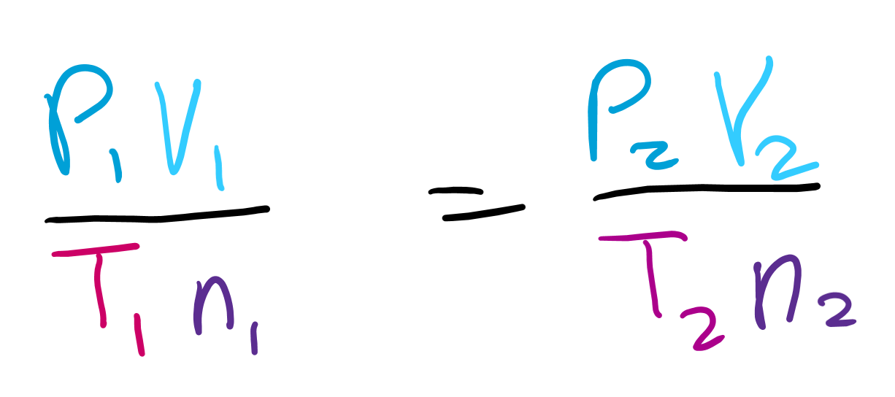
Avogadro's Law + Combined Law
Why are V and n divided?
Hard questions:
Why are P and n divided?
Why are T and n multiplied?

Slide 18
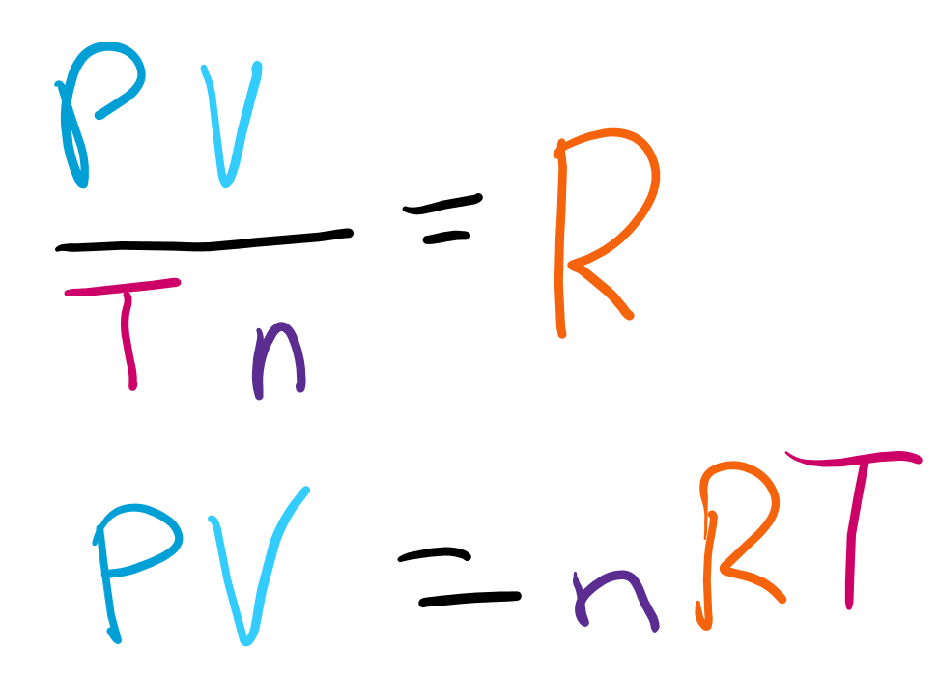
Constants
If PV/nT is always the same, what can we say about it?
We create a constant called R that’s always going to be what PV/nT results in because it’s the same for every gas according to these laws
Multiply both sides by nT and we get the law
Sometimes people call it PVnRT to remember it

